Slide 1
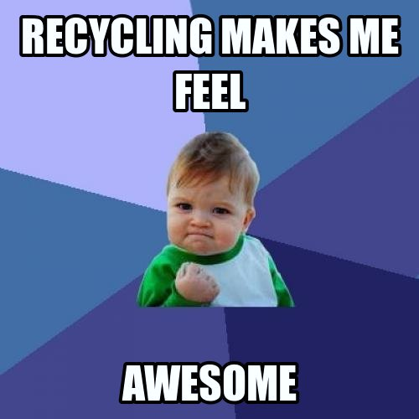
Plastic recycling
Jasmin Männistö and Hanna Juvonen
Laanila High School

Slide 2
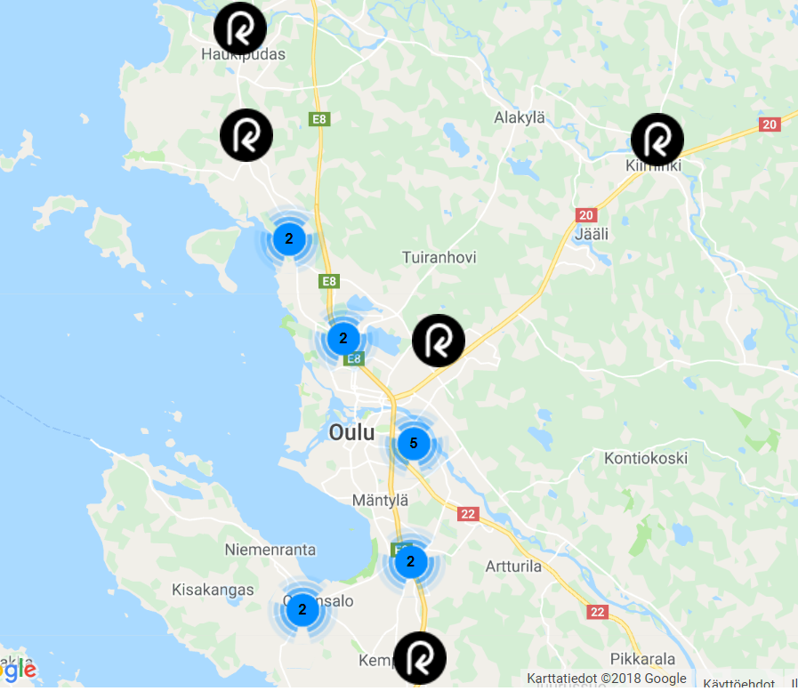
Plastic recycling in Oulu
Rinki eco take-back points
There are 17 recycling spots where plastic can be recycled
There aren’t any in the city center of Oulu because of lack of space
Municipalities, close to Oulu for example Ii, Tyrnävä and Liminka, are aiming to have more plastic recycling spots
Laanila High School is there

Slide 3
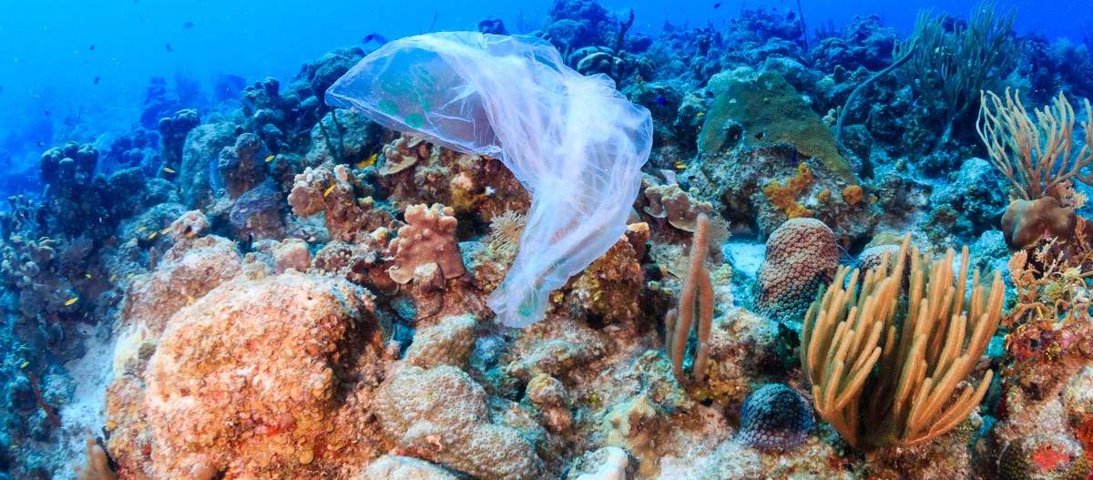
We don’t recycle plastic well enough at the moment. So, a huge amount of plastic ends up in the oceans every year. Plastic pollution is a big problem that we need to solve. Which is why we need more new innovations.

Slide 4
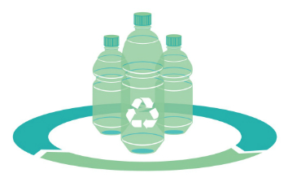
Luckily, there are already many innovations that have helped us recycle plastic!

Slide 5
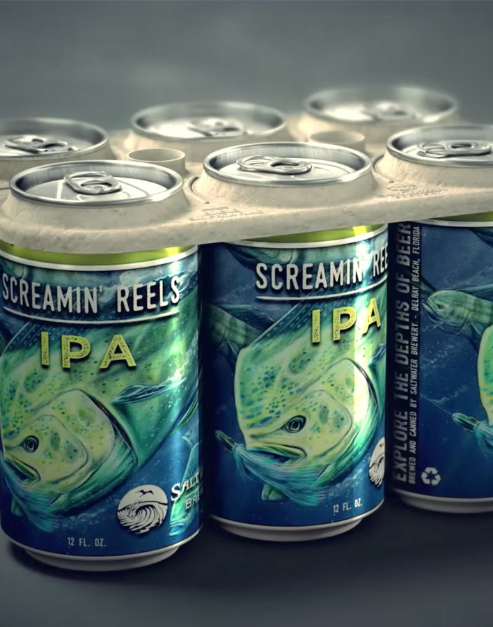
Edible six-pack rings
Plastic that ends up to oceans is harmful to many sea animals as they may for example eat it
Saltwater Brewery in Florida released edible six-pack rings in 2016
These six-pack rings are 100% biodegradable, therefore, sea animals can eat them without being harmed
They are made from barley and wheat ribbons

Slide 6
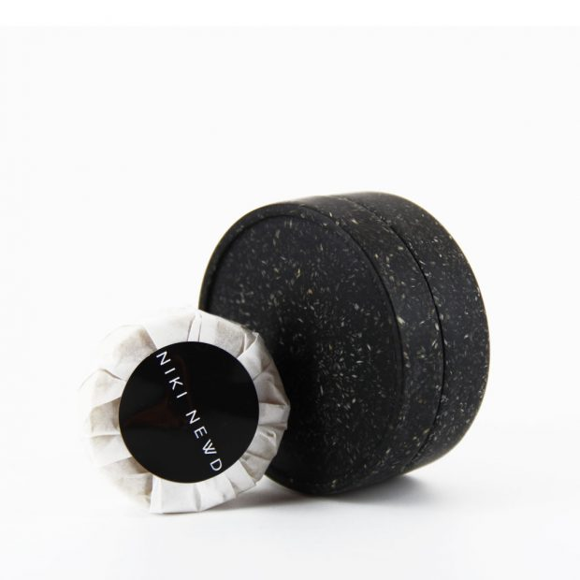
We can replace plastic with biodegradable material called Sulapac®!
By the way Sulapac® is a Nordic product. It’s developed by two Finnish women!

Slide 7
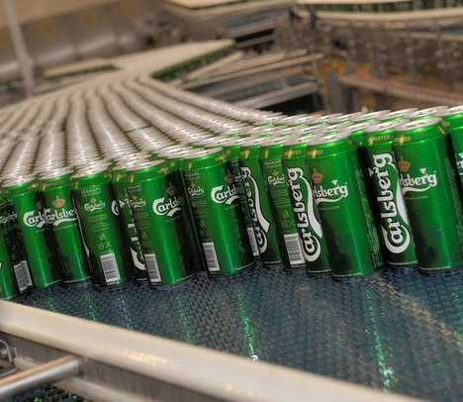
Carlsberg is going to stop using plastic in six-pack packages. They will replace plastic with glue.

Slide 8
Youngsters have also potential to create something new!
Boyan Slat founded his own The Ocean Cleanup -company to rid the world’s oceans of plastic when he was only 18 years old
Interested to know more about his company -> check their website: https://www.theoceancleanup.com/

Slide 9
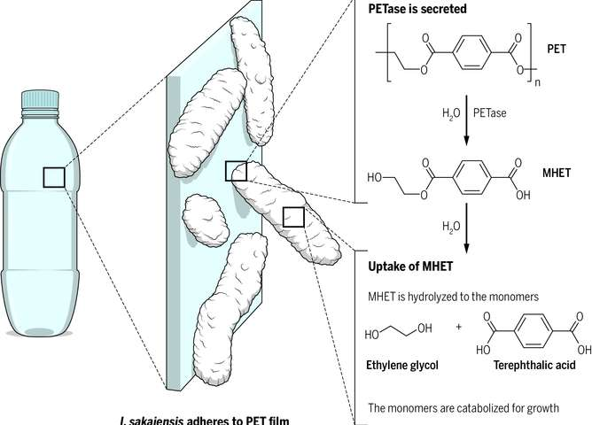
Microbes that can eat plastic
Finnish researchers have found that some microbes are able to eat for example polystyrene (it’s a typical solid plastic that is used for example in plastic cups)
At the moment they are also trying to find out other types of plastic that microbes can eat

Slide 10
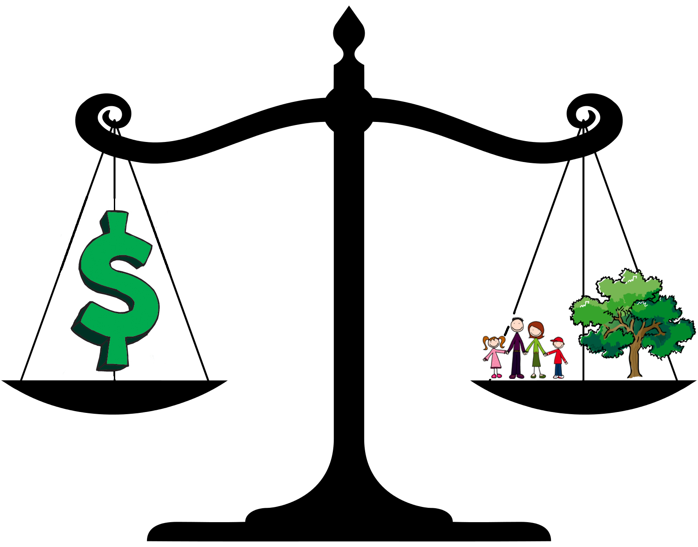
Despite the great innovations, we still need to work hard to solve the plastic pollution problem. Also, for example politicians have to take it into account when they make decisions.

Slide 11
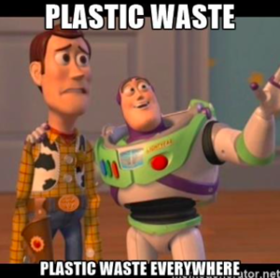
Thank you! Hopefully, you liked the presentation and learned something new!

Slide 12
Sources
https://www.kaleva.fi/uutiset/oulu/muovinkerayspisteita-lisataan-oulun-seudun-kuntiin-oulun-ruutukaava-alueelle-ei-ole-tulossa-muovinkeraysta/805513/
https://rinkiin.fi/for-households/
https://www.norcalcompactors.net/wp-content/uploads/2016/05/Plastic-recycling-business.jpg
https://cdn.vox-cdn.com/thumbor/SlX6JURRGSXddLFw4CNQ4iYc3g4=/0x0:4450x2967/1200x800/filters:focal(1518x1302:2230x2014)/cdn.vox-cdn.com/uploads/chorus_image/image/60256531/shutterstock_684898093.0.jpg
https://www.craftbeer.com/editors-picks/saltwater-brewery-creates-edible-six-pack-rings
https://www.biotalous.fi/taysin-biohajoava-sulapac-materiaali-haastaa-muovin/
https://www.talouselama.fi/uutiset/hyvasti-sixpack-carlsberg-korvaa-muovin-liimalla/e50b6983-5e28-3f30-bbeb-c0e2012b439f
https://www.theoceancleanup.com/
https://mymodernmet.com/wp/wp-content/uploads/2018/05/boyan-slat-ocean-cleanup-great-pacific-garbage-patch-thumbnail.jpg
https://www.hs.fi/kotimaa/art-2000005914400.html
https://3c1703fe8d.site.internapcdn.net/newman/csz/news/800/2016/1-newplasticmu.jpg
http://lgam.wdfiles.com/local--files/optimised-decision-making/optimised-decision-making.png
https://pbs.twimg.com/media/DABESQBVoAA8jtF.jpg
http://motleywonder.com/wp-content/uploads/2017/05/Screen-Shot-2017-05-29-at-21.39.50-300x298.png

