Slide 1
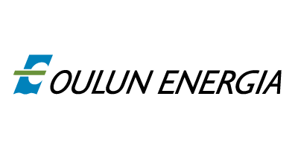
Oulu’s waste incinerator
https://www.youtube.com/watch?v=k8aOgD__gec
Meeri Översti & Kyla Castro
“There is an enormous amount of energy within the chemical bonds of the waste that has not been utilized - until now."

Slide 2
Laanila's ecopowerplant

Slide 3
Most significant facts about Oulu’s waste incinerator
"Every year, Northern Finland creates over 160 000 tons of waste that is then placed in landfills. Landfills began to fill up fast and the waste began to put a strain on the environment."
"The power plant in Laanila notably reduces environmental impact of the nearby landfill, Rusko, by making use of 120,000 tons of waste a year."
“The amount of waste that yearly ends up in Rusko's landfill has been reduced to 40 000 tons.”

Slide 4
The day-to-day process
”Daily, 40-50 garbage trucks arrive at the Laanila eco power plant where they are unloaded to waste shafts that then lead to the big waste bunker. The waste is not stored around the facility at any point.”
”The waste bunker is a temporary 9,000 m³ concrete storage for the waste. Two grab unloaders are mixing the waste and feeding it from the bunker to the furnace about every 15 minutes. One grabload contains 2-4 tons of waste. Which can be 10 years worth of waste for one person.”
”The furnace has optimal circumstances for the waste to burn. The temperature is over 850°C. The heat causes the water in the pipes to vaporise. The steam can be up to 515°C and its pressure 87.9 bars. The energy from the steam is directed to the turbines of the Laanila eco power plant, where it’s used in Kemira’s industrial processes and Oulus’s Energy production of electricity and district heating.”

Slide 5
The purification of the toxins
”The waste burning process forms flue gases and ash. The flue gases are processed in a seperate purification device.”
”The first step of the purification process happens in the cooling device where the temperature of the gas is lowered enough to fit the chemical reactions.”
”In the second step, chemicals like slaked lime and active carbon are added to the cooling device to help purify the flue gases. The chemicals react with the flue gases and remove any toxic compounds in the process.”
”In the third step, the flue gases are directed to a bag filter, where the reaction products of the gases and the chemicals are removed with the remaining fly ash.”
”After all this, the purified gases are below the required emission limits. Just before the flue gas is directed up the 90 metre pipe, the remaining thermal energy of the gas is stored and used for the production of district heating.”

Slide 6
The end product
“About 20-25% of the incinerated waste become ashes and cinder. The cinder is then delivered to Rusko's Landfill where it’s aged and filtered.
“In the filtering process iron, copper, aluminium and stainless steel is removed. The filtered cinder is then utilized in construction. Metals are brought back to industries where they are to be recycled and used again.”
“A small ratio of the ash; flue gas's purification product and furnace ash are categorized as hazardous waste. Ekokem Oy, based in Pori, is responsible of appropriate after-care of the hazardous waste.”

Slide 7
Regulations
"EU's waste incinerating directive and the power plant's environmental permit regulates the operation of the power plant, the amount of emission and its surveillance. The emission limits are clearly smaller than the limits of traditionally functioning power plants. The incineration of waste emits so little that they are not considered problematic in any area of the EU."
"Air emissions and the water going into Oulu River are constantly being monitored. The results are reported to the authorities regularly."
“The transport, acceptance, storage and processing doesn't have any negative effects on the power plant's vicinity nor on its transportation route."
"The odor is being limited by using technical solutions. When it comes to noise, the power plant follows all the regulations."
"Laanila's Eco Power Plant shifts Northern Finland's waste disposal into the more modern European standard. From waste to clean energy - that is northern energy."

Slide 8
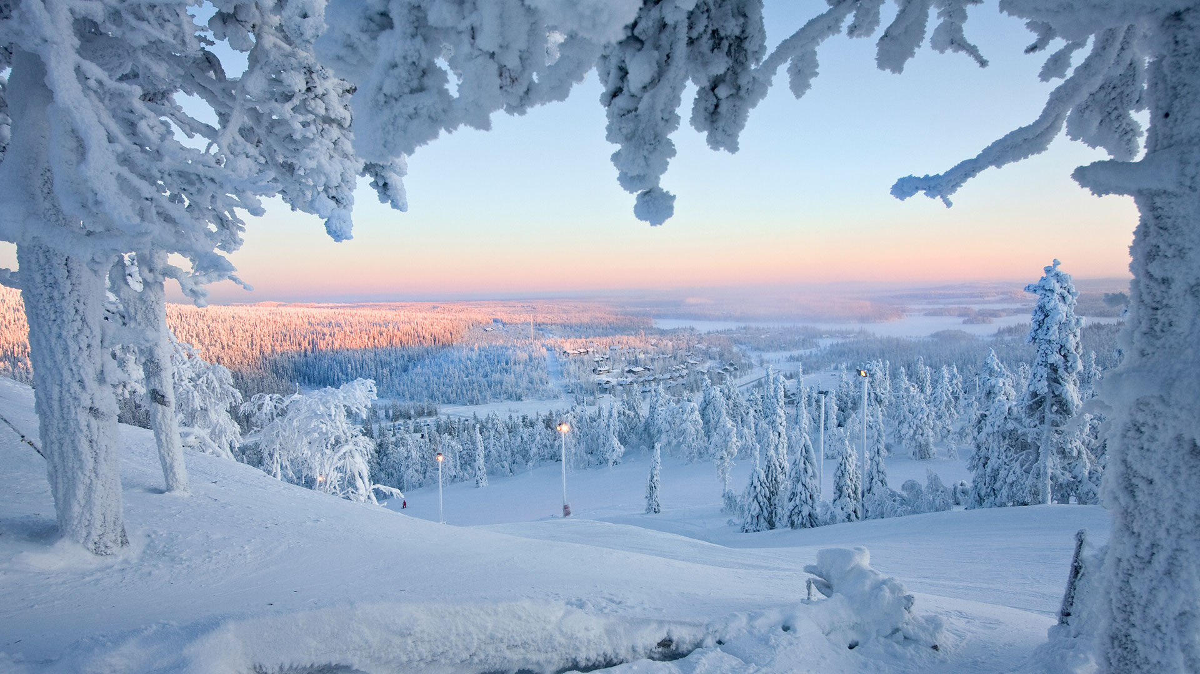
Thank you!

