Slide 1
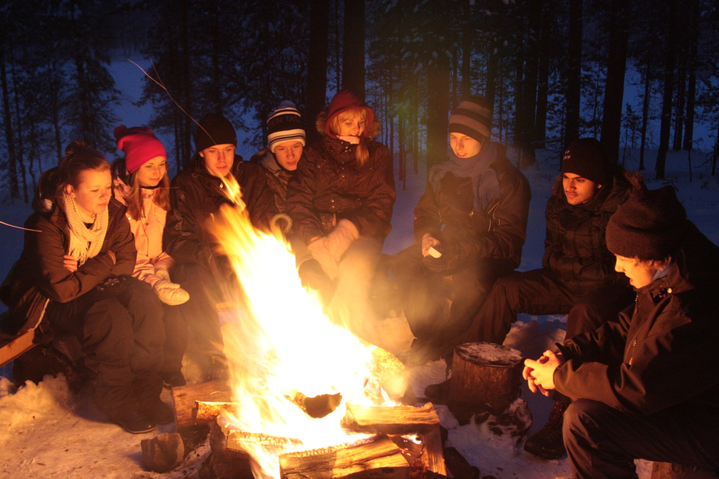
Green flag –action of Laanila school

Slide 2
Introduction
Laanila school has been about 9 years a green flag school
School got onto so-called permanent green flag level on 2011
Until now the themes have been: the reduction of waste, energy and cooperation (with other schools, kindergartens and elderly persons)
2 teachers and about 20 students are participating actively in Green flag -action
It is voluntary to take part to the action

Slide 3
There is different kind of theme days during the season (electroless day , second hand store, environmental comfort, voluntary work)
In the beginning of the season the group starts team-building with a little trip together
The group meets once a month
Pupils organize kahoots and competitions of different themes for example climate change

Slide 4
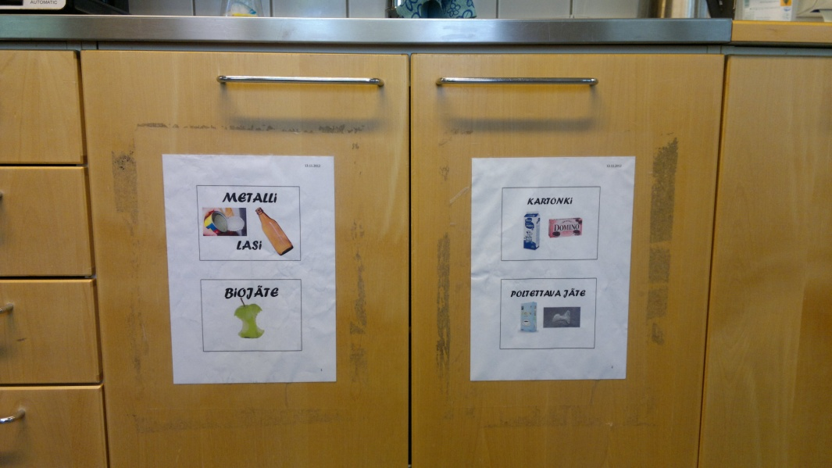
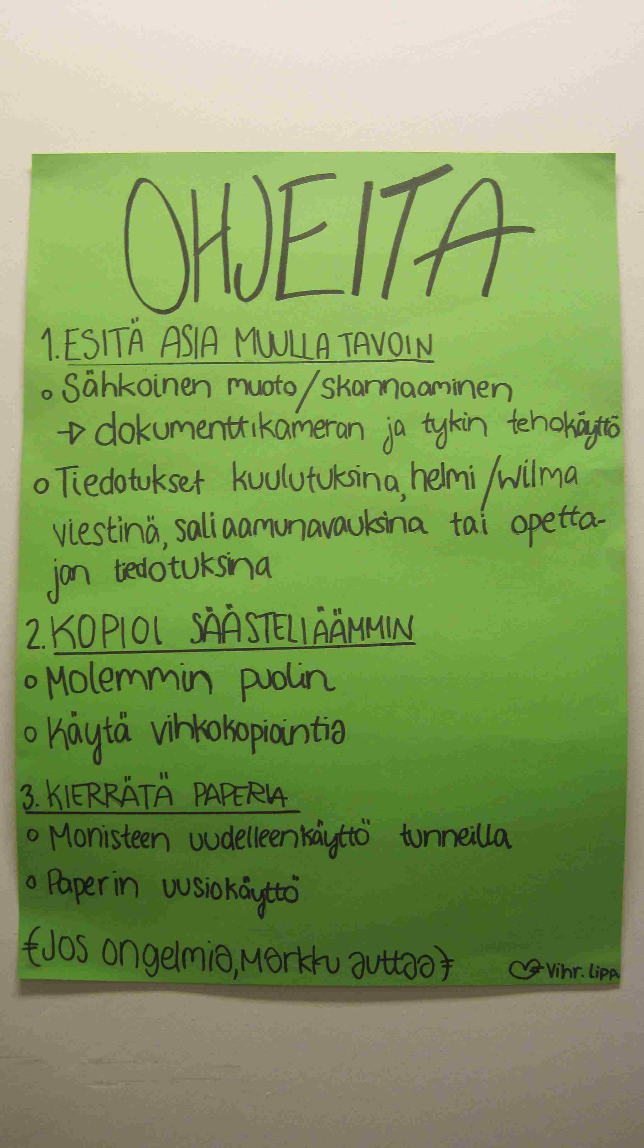
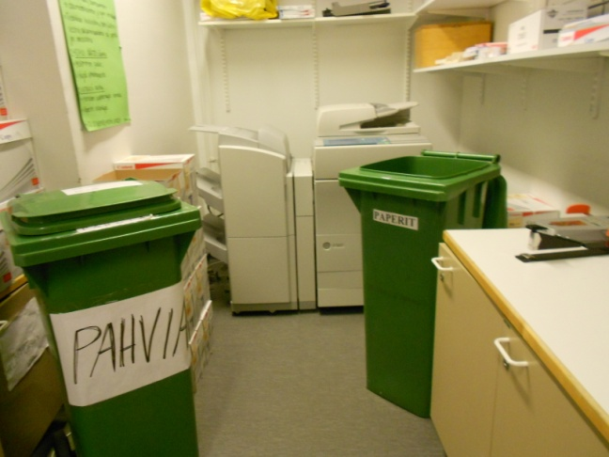
The reduction of waste

Slide 5
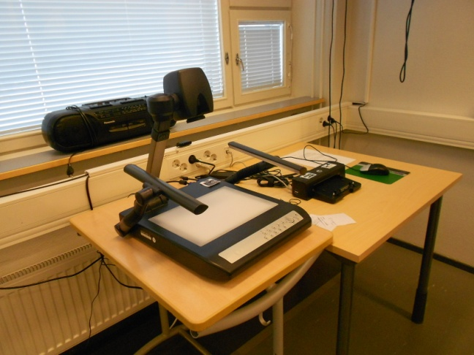
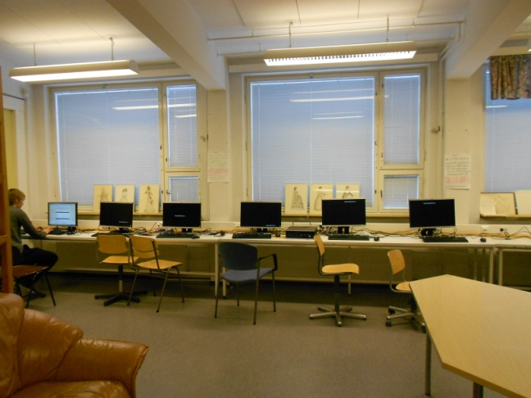
Saving energy

Slide 6
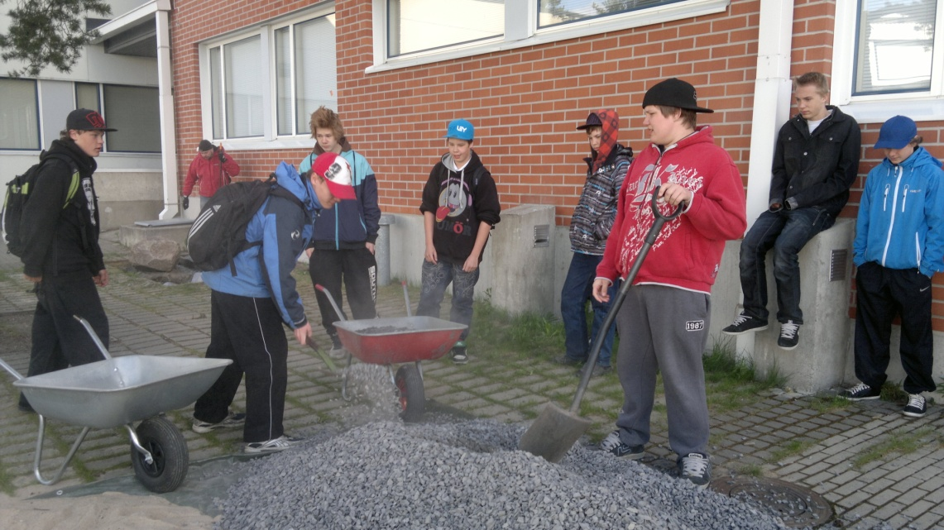
Increasing the environmental comfort

Slide 7
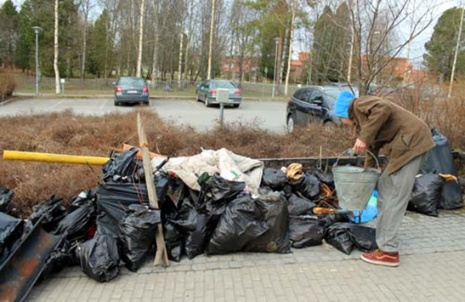
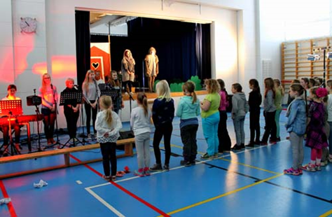
Environmental day
We gather litter in surrounding areas
We have got visitors from lower comprehensive school and our pupils organize kahoots and a play and sports for them

Slide 8
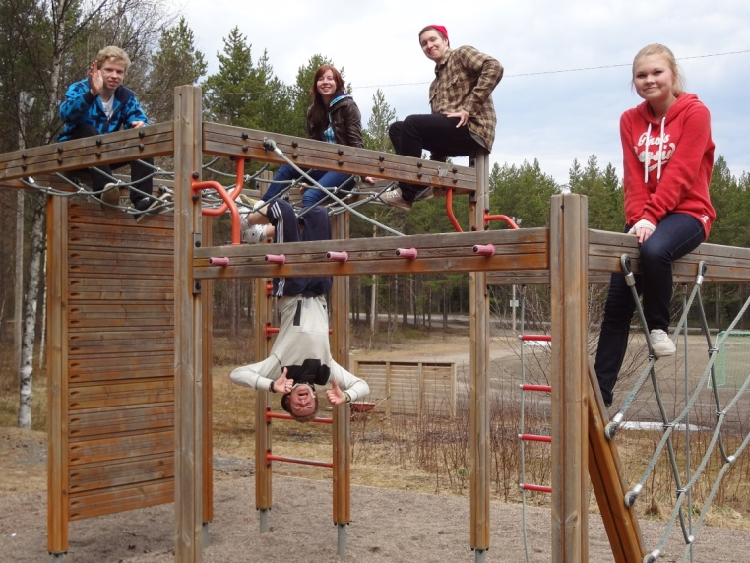
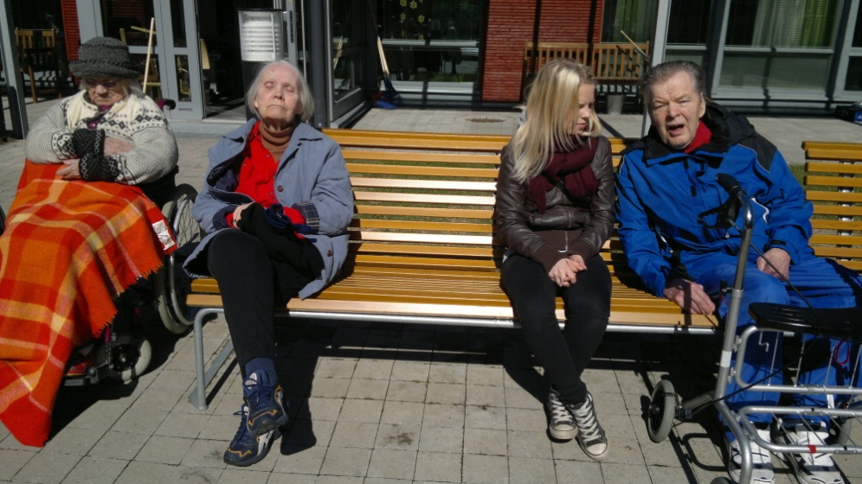
Voluntary work

Slide 9
Visiting Ruskon jätekeskus 2018

Slide 10
School lunch project: visiting potato farm 2018

Slide 11
Partnership school in Scotland
Eco Schools e-twinning project with Kemnay Academy
Litter and waste (responsible consumption), energy, biodiversity (life below water) , fair trade (no poverty), health and well-being

Slide 13
Our action continues...

